Slide 1

About me
Currently working as Senior Data Scientist @Publicis Groupe
6+ Years of Experience in Data Science and Machine learning
Led and Mentored teams in various Hackathons
B.Tech in CSE from Jamia Millia Islamia. M.Tech in Data Science from IIT Hyderabad

Slide 2
Content
Brief Introduction to Clustering
Understanding KMeans Algorithm
Limitations
Improvements
Code Walkthrough
Evaluation metrics

Slide 3
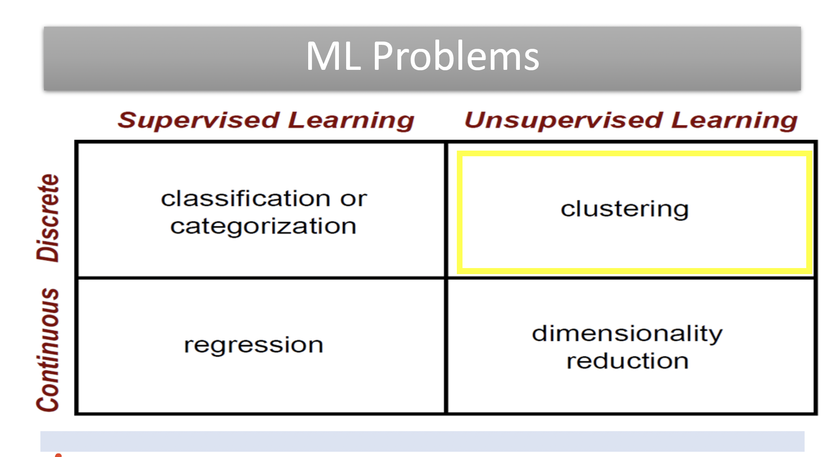

Slide 4
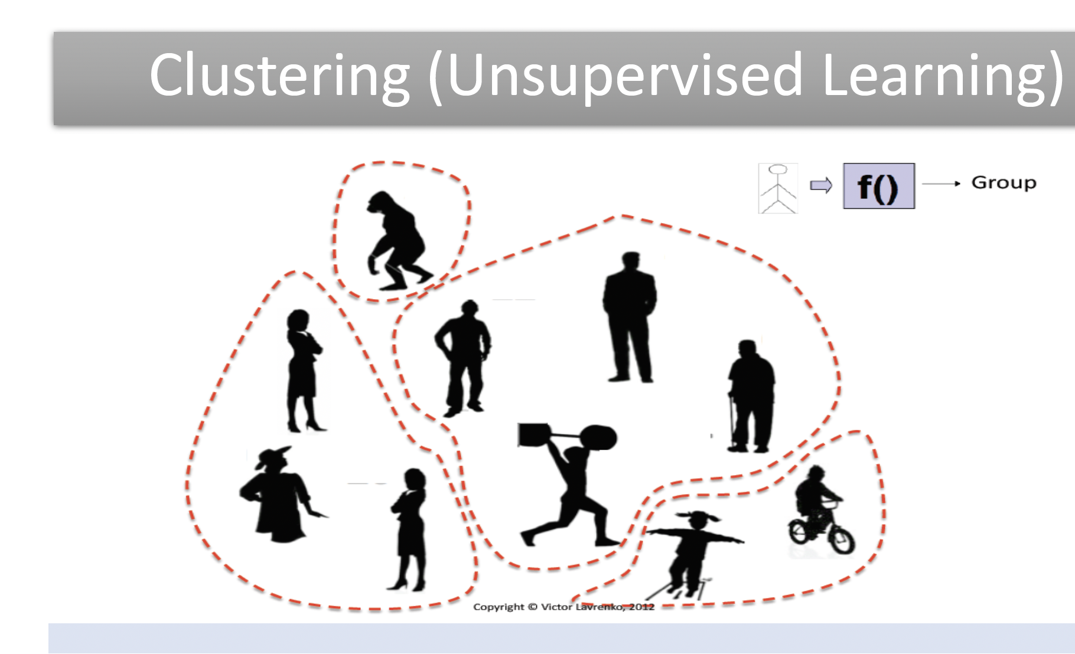

Slide 5
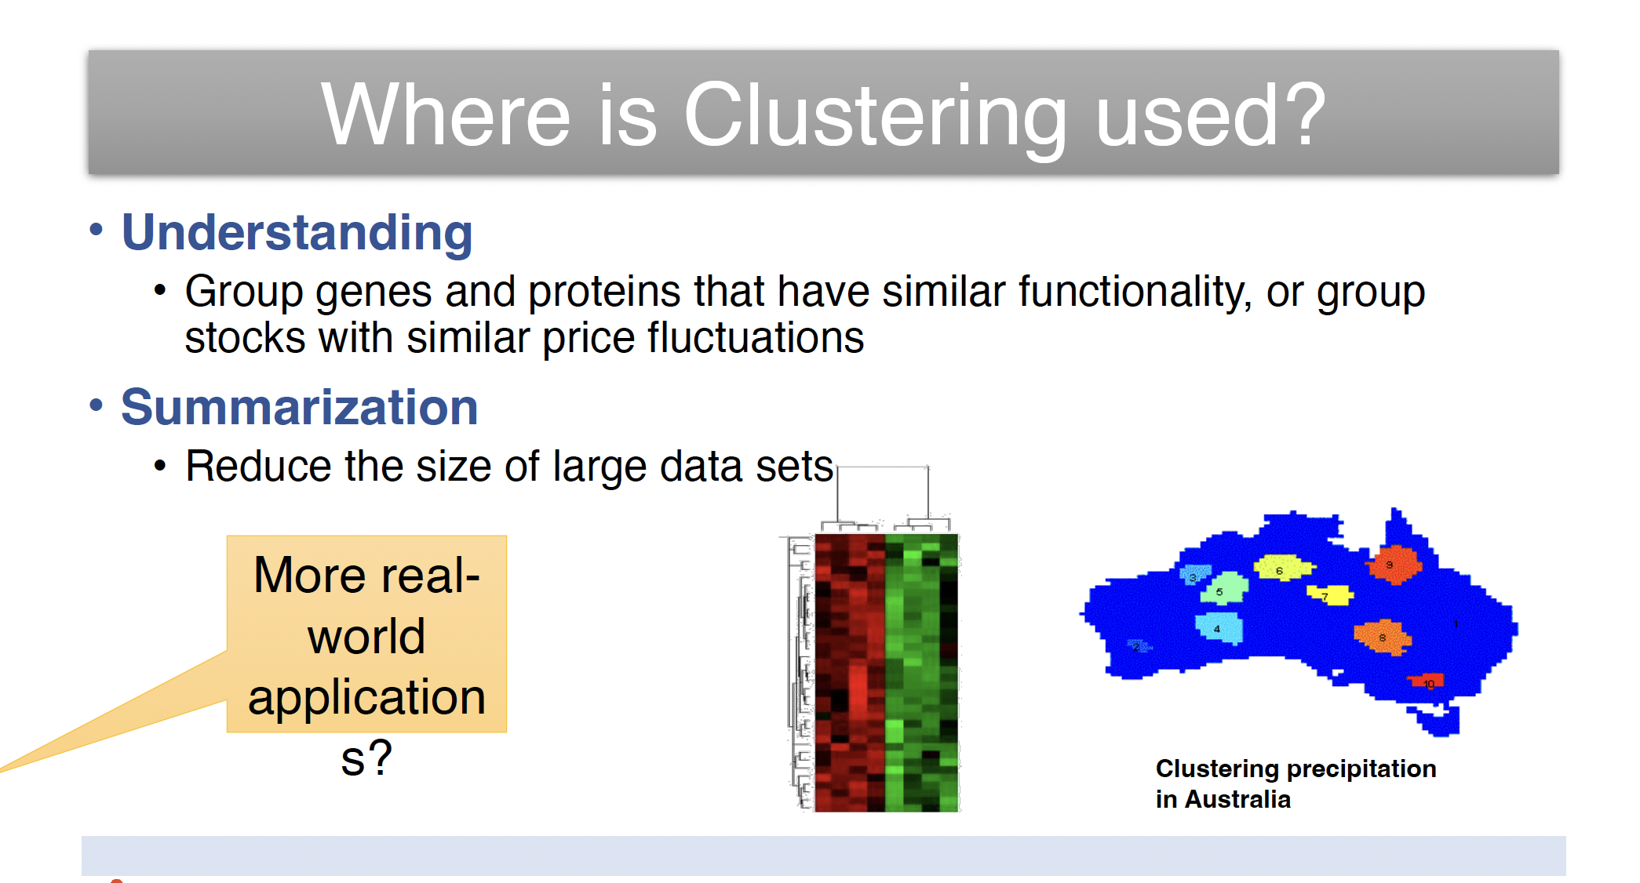

Slide 6
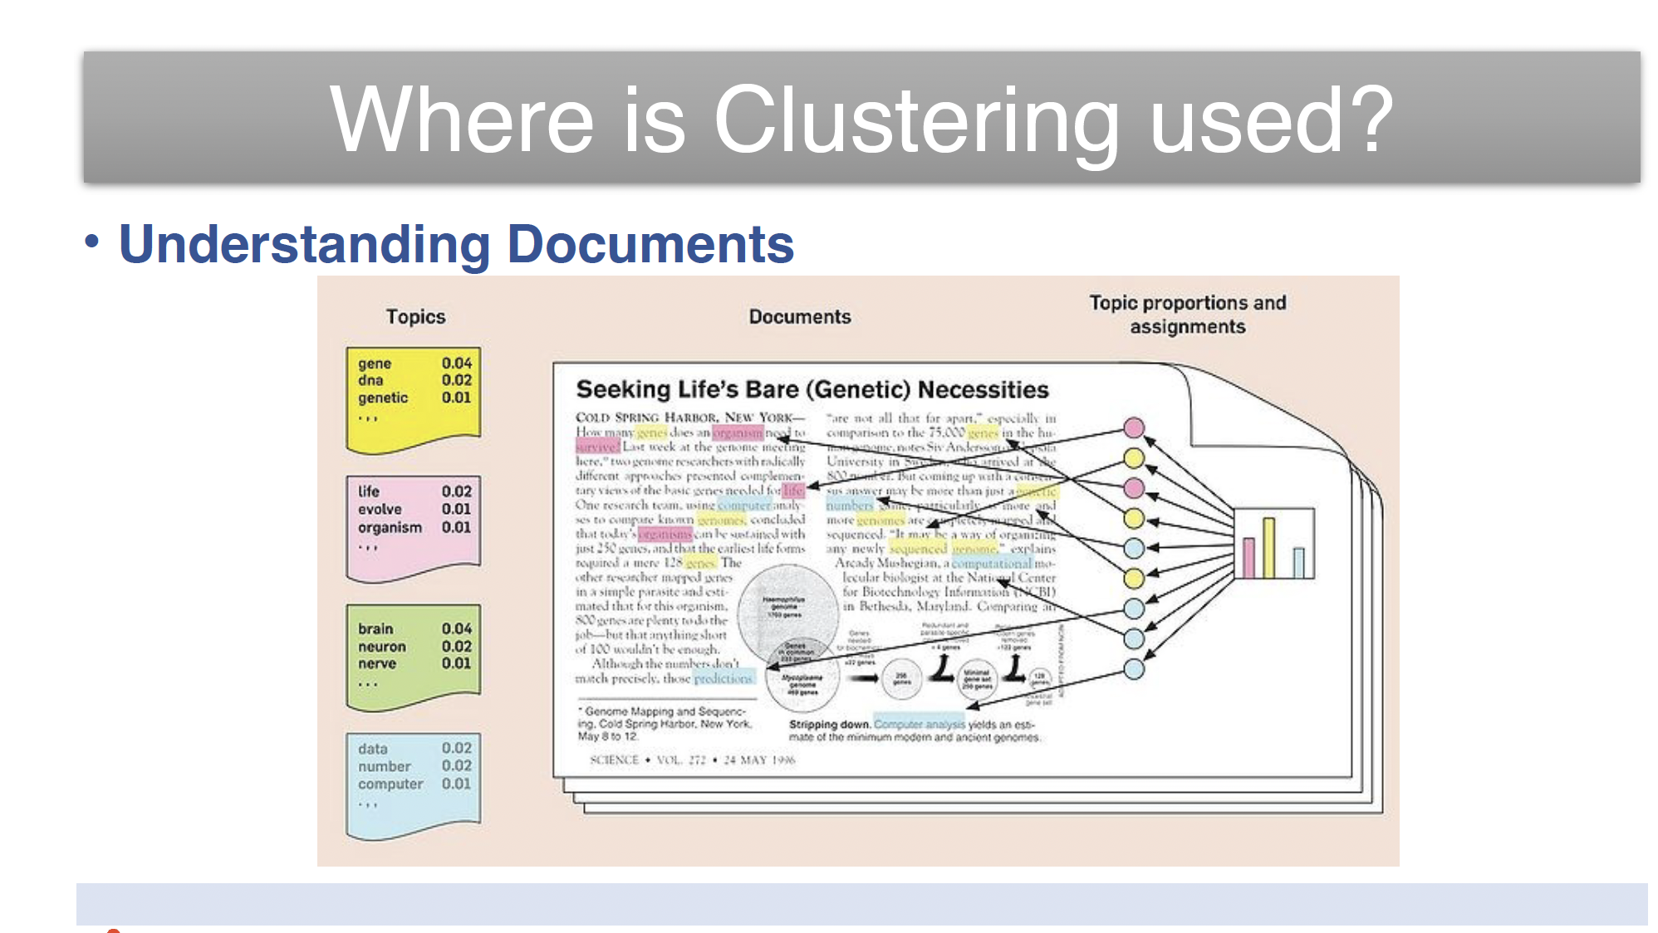

Slide 7
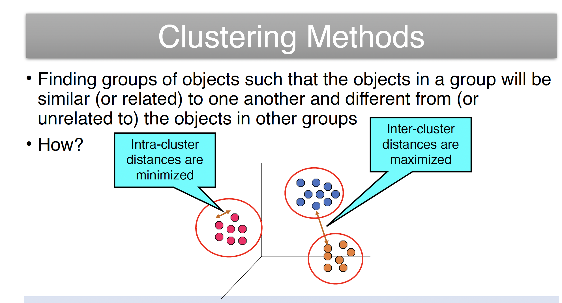

Slide 8
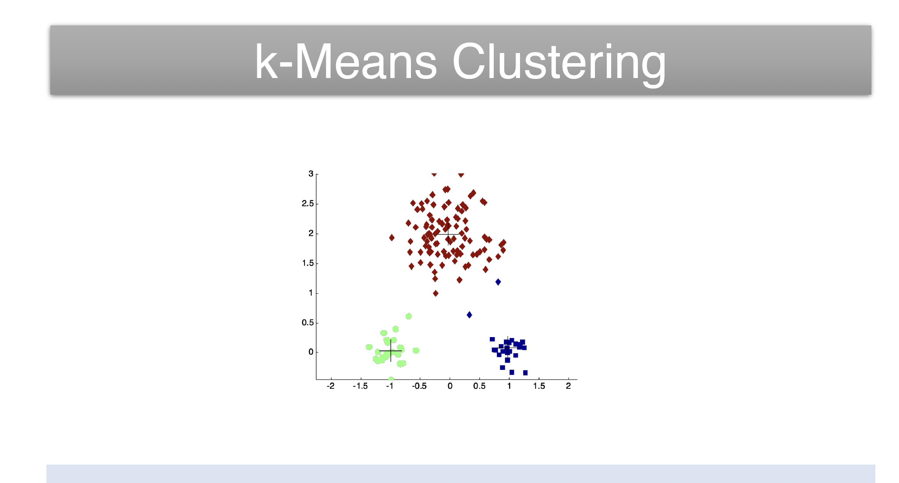

Slide 9
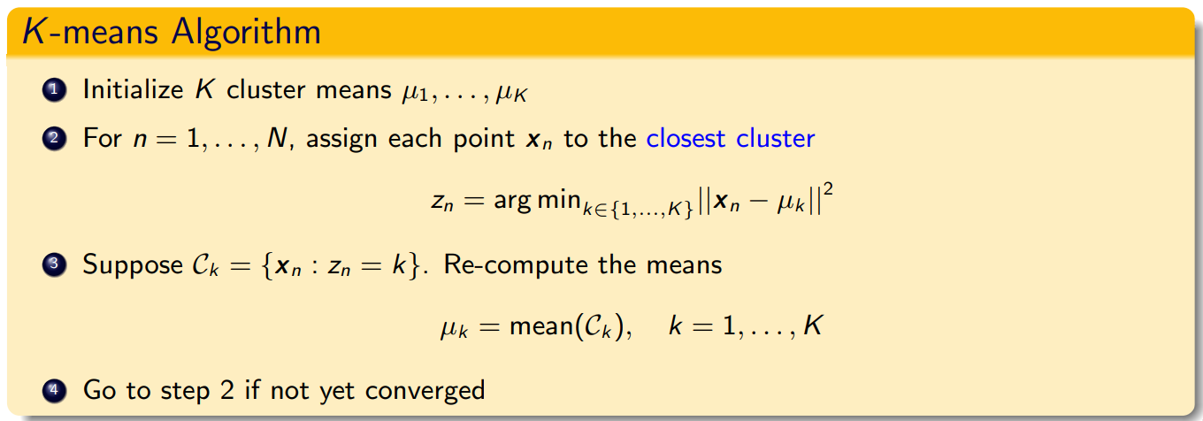
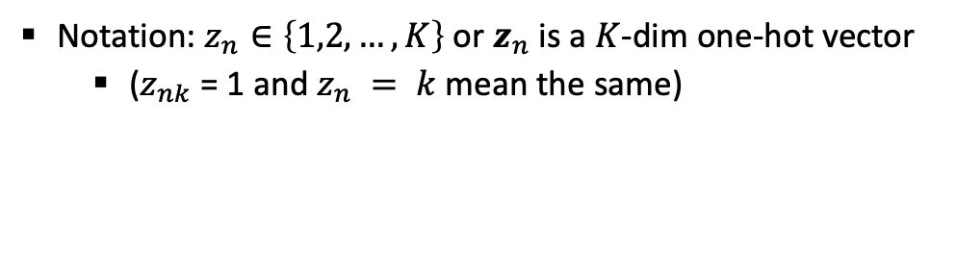
K-means algorithm
Notation: $z_{n}∈\left\{1,2,…, K\right\}$ or $z_{n}$ is a $K$-dim one-hot vector
($z_{nk}$ = 1 and $z_{n} = k$mean the same)

Slide 10
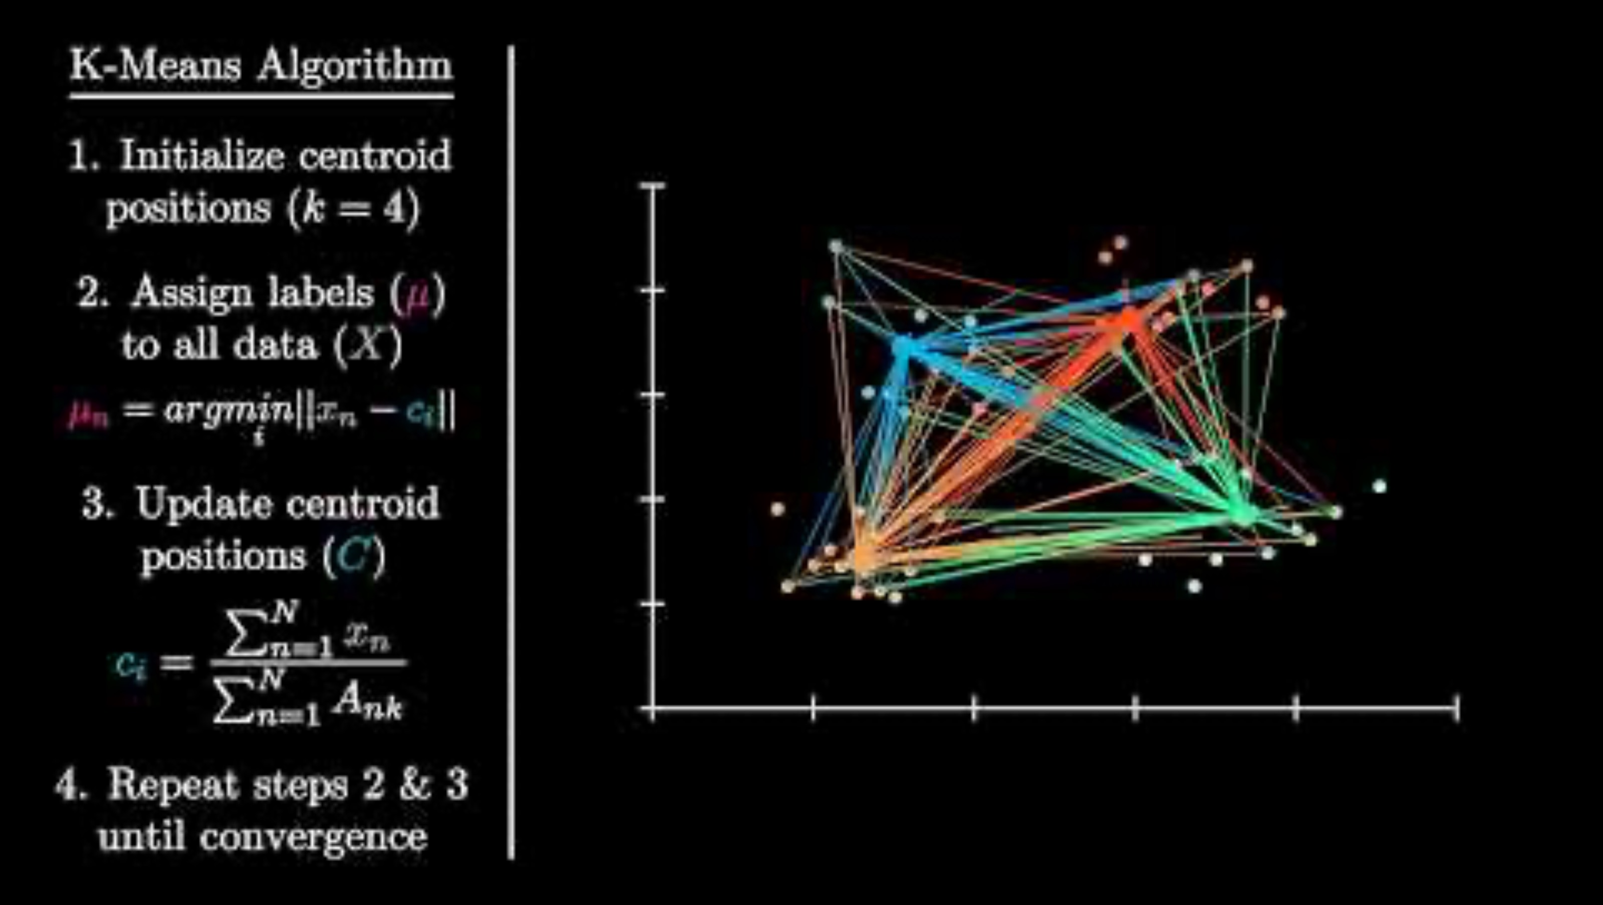
How the K-Means Clustering algorithm works?

Slide 11
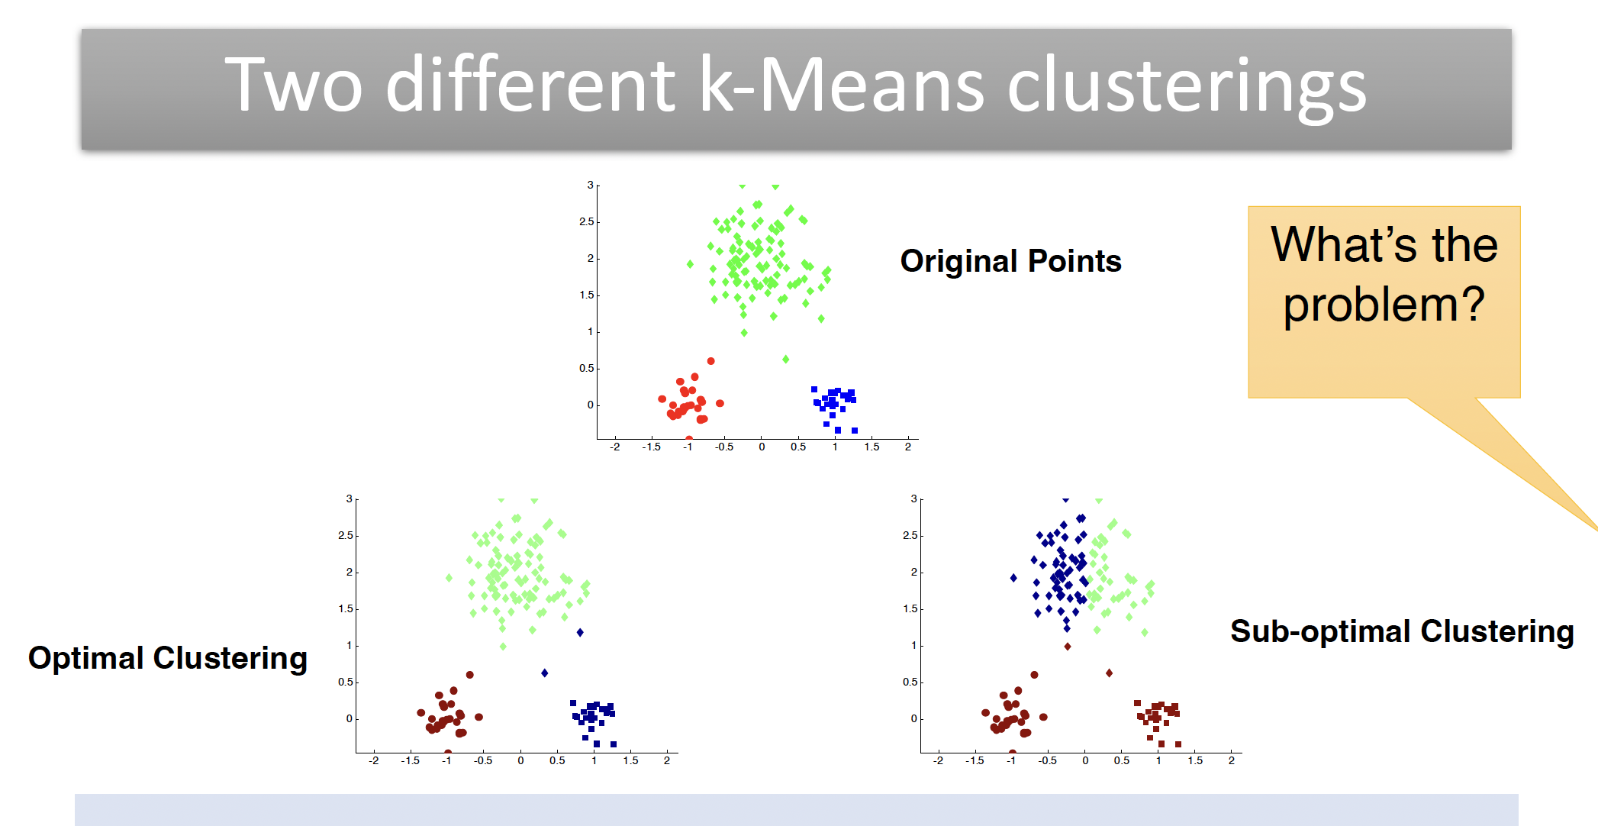

Slide 12
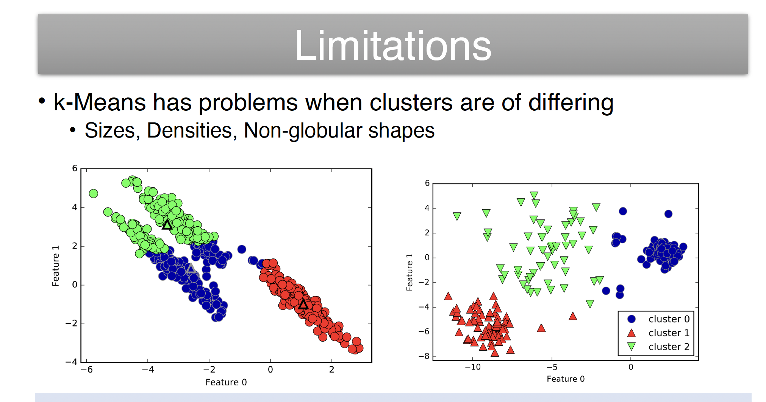

Slide 13
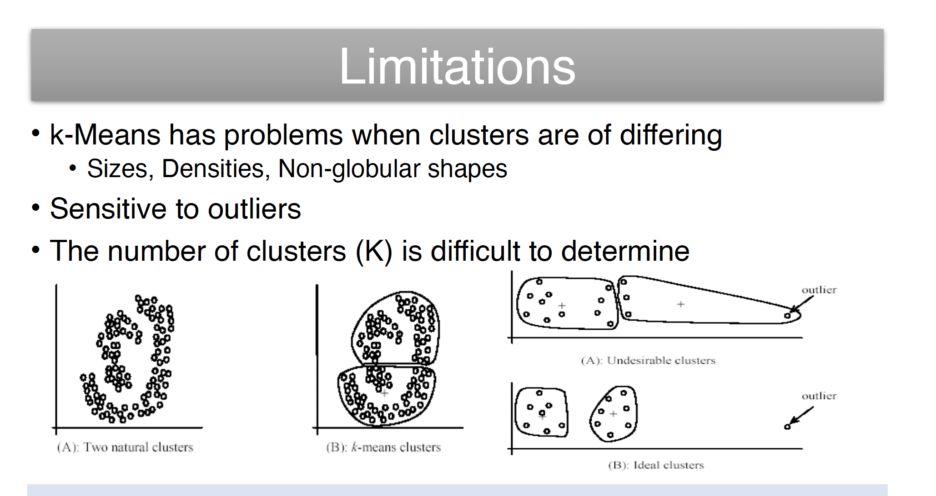

Slide 14
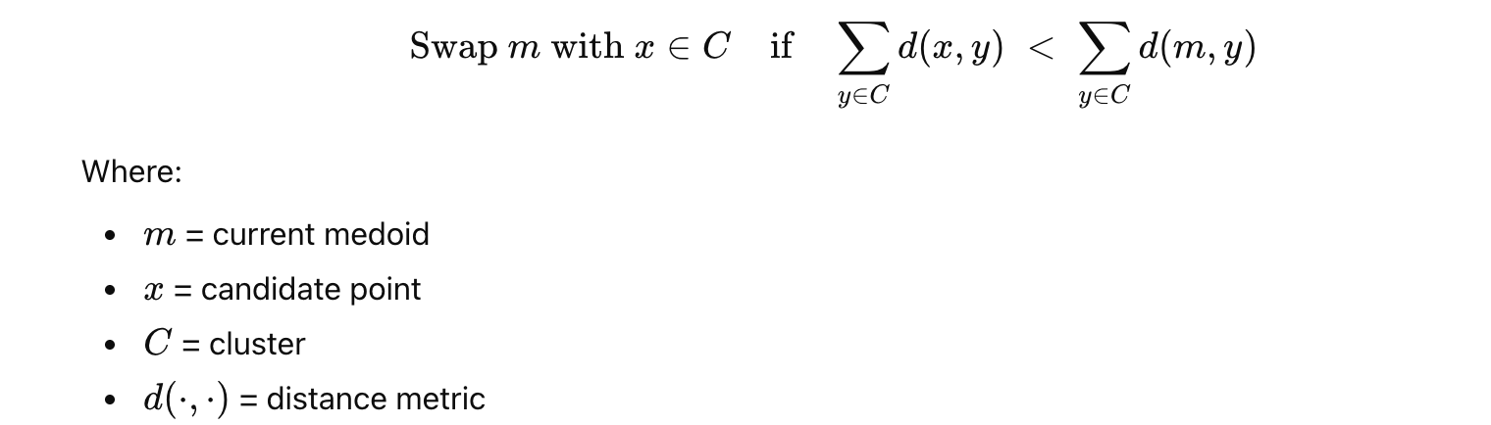
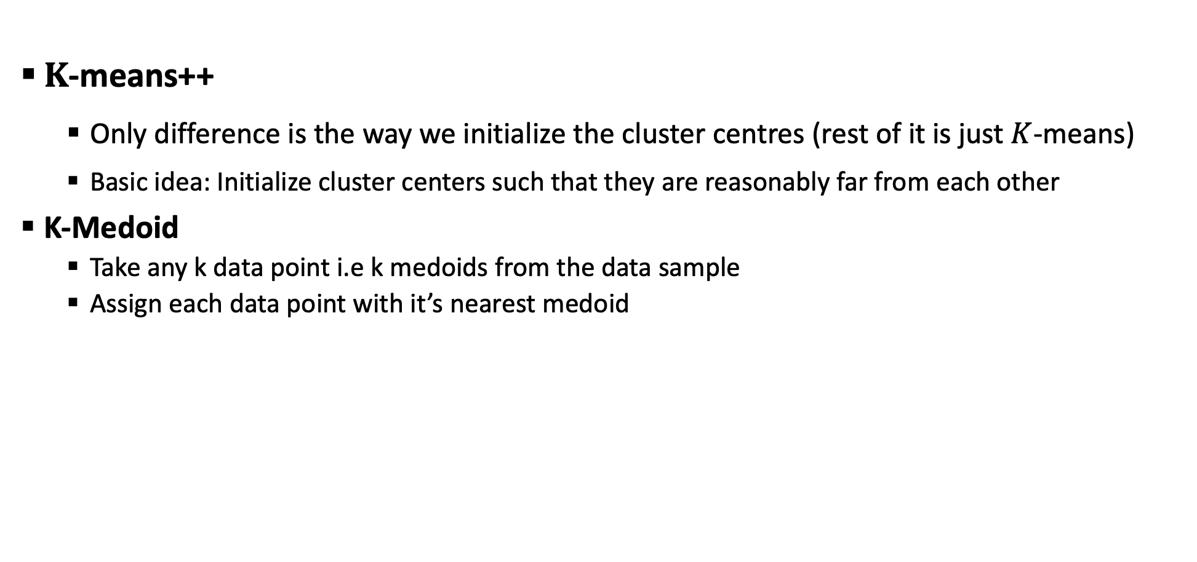
Improvements of KMeans
$K$-means++
Only difference is the way we initialize the cluster centres (rest of it is just $K$-means)
Basic idea: Initialize cluster centers such that they are reasonably far from each other
K-Medoid
Take any k data point i.e k medoids from the data sample
Assign each data point with it’s nearest medoid

Slide 15
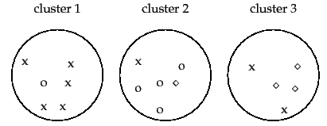
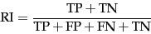
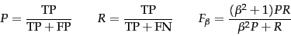
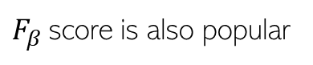
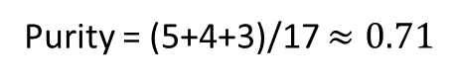
Evaluating Clustering Algorithms
Purity: Looks at how many points in each cluster belong to the majority class in that cluster
Rand Index (RI): Can also look at what fractions of pairs of points with same (resp. different) label are assigned to same (resp. different) cluster
Sum and divide by total number of points
3 classes (x, o , , assuming known ground truth labels)
5
4
3
Purity = (5+4+3)/17 $≈0.71$
Close to 0 for bad clustering, 1 for perfect clustering
Also a bad metric if number of clusters is very large – each cluster will be kind of pure anyway
True Positive: No. of pairs with same true label and same cluster
True Negative: No. of pairs with diff true label and diff clusters
$F_{β}$score is also popular
Precision
Recall
False Positive: No. of pairs with diff true label and same cluster
False Negative: No. of pairs with same true label and diff cluster

Slide 16
references
Code https://github.com/Abhinav1004/BAI_Session
Document-Level Text Simplification: Dataset, Criteria and Baseline(Sun,Wan)
Evaluating Document Simplification: On the Importance of Separately Assessing Simplicity and Meaning Preservation (CripWell et al)
Graph-based Model Using Text Simplification (Xu,Pan 2021)

